Slide 1
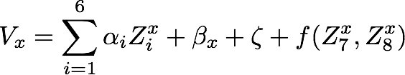






Statistical Model
I Br Cl MA CS FA
Solvent -> (Polarity, minimum volume of enclosing eclipse)
ion: 1 2 3 4 5 6
Solubility of solution x: (solubility = - Energy)
: ion i present in solution x, for i = 1...6
: Polarity, maximum volume of enclosing eclipse
: a 2-d Gaussian process with prior mean and covariance
Place normal prior distributions on
Estimate hyper-parameters with MLE based on historical data

Slide 2
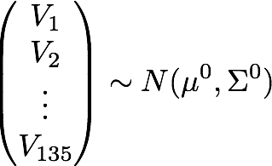

Statistical Model - Cont
Since a normal prior is placed on each of the parameter,
After each observation, we can update the mean and covariance.
We use to denote the mean and covariance of the multivariate normal after n observations.

Slide 3

Using EI to decide where to sample next
Let be the largest solubility among the n observed samples so far. The expected improvement (EI) of a solution x is:
Next solution to evaluate:

